Slide 1


2019
Netcoreconf
Securing .Net Core APIs and WebApps with Azure Active Directory
Luis Mañez
Cloud Architect – ClearPeople LTD
@luismanez
26/01/2018

Slide 2

Securing .Net Core APIs and WebApps with Azure Active Directory

Slide 3
Sponsors

Slide 4


The Protocols
oAuth2
Provides Authorization framework
OpenIdConnect
Built on top of oAuth 2
Provides Authentication capabilities
/UserInfo endpoint
IdToken
Discovery service
/Authorize endpoint
Access Token
/Token endpoint
Refresh Token

Slide 5










The Players
Client (AKA App)
Public: native, mobile, user agent
Confidential: server
Authorization Server
Resource Owner
(AKA User)
Resource Server

Slide 6
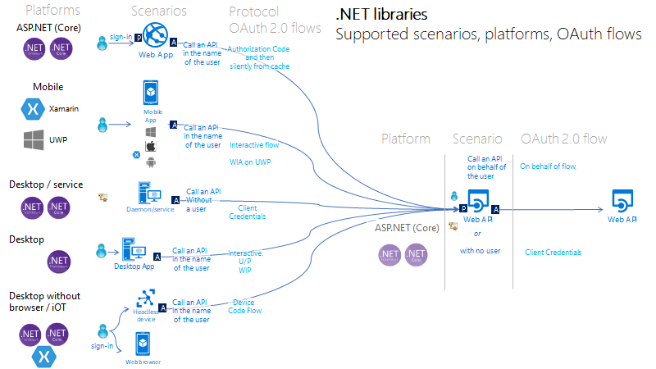
https://github.com/AzureAD/microsoft-authentication-library-for-dotnet/wiki/scenarios

Slide 7
https://joonasw.net/view/azure-ad-v2-and-msal-from-dev-pov
https://github.com/AzureAD/microsoft-authentication-library-for-dotnet/wiki/Adal-to-Msal
https://docs.microsoft.com/en-us/azure/active-directory/develop/sample-v2-code
https://github.com/AzureAD/microsoft-authentication-library-for-dotnet/wiki/scenarios
Manifest API: "accessTokenAcceptedVersion": 2
https://azure.microsoft.com/en-us/resources/samples/active-directory-dotnet-webapi-onbehalfof/
For the middle tier web API (TodoListService-OBO) to be able to call the downstream web APIs, the user must grant the middle tier permission to do so in the form of consent. However, since the middle tier has no interactive UI of its own, you need to explicitly bind the client app registration in Azure AD, with the registration for the web API. This binding merges the consent required by both the client & middle tier into a single dialog, which will be presented to the user by the client. You can do so by adding the "Client ID" of the client app, to the manifest of the web API in the knownClientApplications property.

Slide 8
Más información:
info@netcoreconf.com
@Netcoreconf
Visítanos en:
2019.Netcoreconf.com
GRACIAS

Slide 9
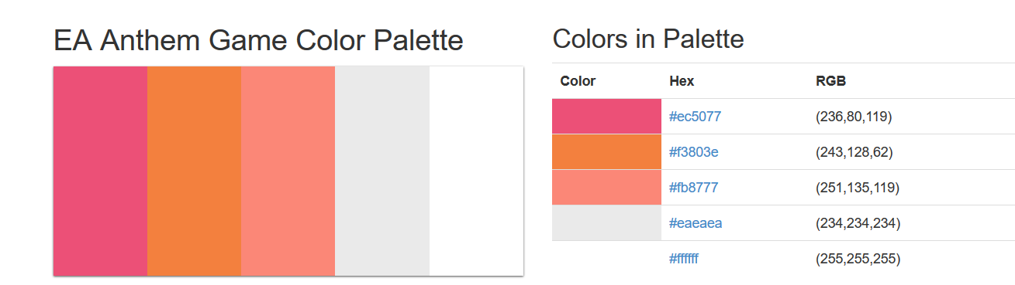

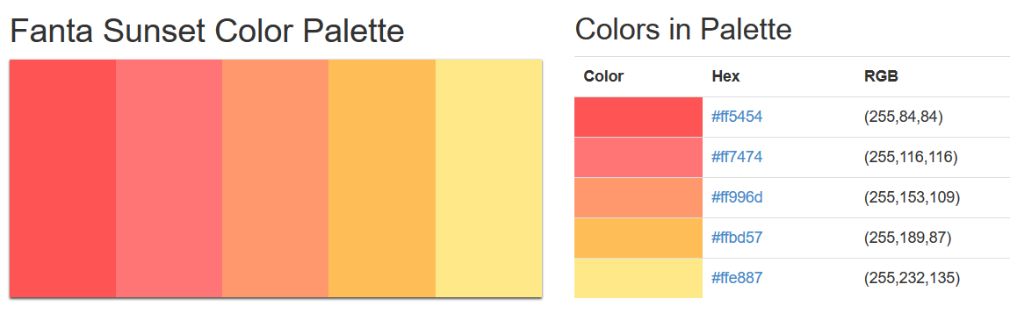
sambori
sam
bori
1
sambori
sambori
sambori
sambori
sambori
sambori
s
a
r
i
sambori
sambori
m
b
o
sambori
sambori
sambori
sambori
sambori
sambori

